Slide 1
EMERGENCY CLINIC
Huddle Room 223, 2D.
Review Syllabus and Attendance Policy
Name plates are mandatory!
Clinical Director of Emergency: Dr. Woo
Administrative Coordinator: Liz Concepcion

Slide 2
CLINICAL EMERGENCY ROTATION
Develop critical thinking skills
Develop communication skills with patients who are in pain
Experience dental emergencies you will see in your practice
Diagnose and treat in a timely manner
Use of insurance codes with proper documentation
Writing common prescriptions for emergent care
Notes:
THIS ROTATION WILL GIVE YOU THE FOUNDATION AND SKILL SET NEEDED IN BUILDING A PRACTICE. You cannot treat what you can’t diagnose.

Slide 3
Remember
Active Patients of Record- manage in the Group
See GPC to make them appointment
Don’t get them to come through emergency
If on block out of school email or call GPC/GPL

Slide 4
How do you form a diagnosis?

Slide 5
How do you form a diagnosis?
1) Clinical Exam
Allows you to determine what kind of radiographs you might need.
Allows you to look at the tooth/teeth the patient is describing as the problem. What the patient points to may not necessarily be the problem. Pain can be referred.
2) Objective/Special Tests
- Endo tests: pulpal status
- Perio tests: status of the periodontium: percussion, palpation, - probings, furcation, mobility
3) Radiographs:
- PA xray: Length of root, is this tooth restorable?
- Bitewing xray: Accurate bone level, endo access, crown length
- Pano: Assess third molars or other anomalies

Slide 6
Emergency Patient Visit Guide
Pt signs Limited in scope consent. INTESC. EM is the source code not your GP#.
Inform patient they are incurring costs for radiographs, exam and treatment.
The start check consists of med history approved by faculty.
Clinical Exam: Emergency worksheets (EMGREC) are used to gather objective findings
Chart perio findings in the perio chart (pocket depths, furcation, mobility).
Based on objective findings, propose radiographs to obtain faculty approval.
Review radiographs, objective/special tests, restorability in EMGREC. Diagnosis?
What is the final treatment procedure plan (code) based on the dx?
Enter the treatment procedure code and codes for radiographs taken.
Faculty approves/swipes the treatment plan. Pt signs the tx plan.
Get financial approval with cashier if cash paying or see PCC get P* removed before starting any procedure.

Slide 7
Limited in Scope Consent

Slide 8
Limited in Scope Consent 2

Slide 9
Limited in Scope:
Attachments
Consents
Chart add
Scroll down to find INTESC (alphabetical order)

Slide 10
Limited in Scope Consent 3

Slide 11
Limited in Scope Consent 4

Slide 12
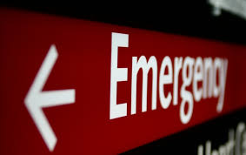
Medical Conditions
Always take Full Medical History and obtain faculty approval swipe before you start any intraoral exam. The start check!
Check if Diabetic, (medication taken, blood sugar level, what did they eat before the appt?) IF in doubt get Glucometer from dispensary.
BP 180/110 CUT OFF
HIV pts w/no lab documentation: pt phones their MD and requests labs to be faxed to Liz, ER coordinator, at 415 351-7187

Slide 13
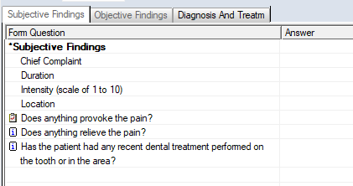
AXIUM- EMGREC
Forms => Emergency Findings
Subjective Findings

Slide 14
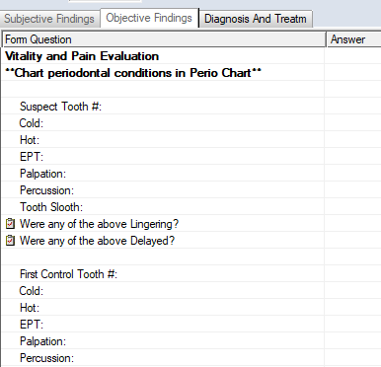
Objective Findings

Slide 15
Diagnosis and Treatment

Slide 16
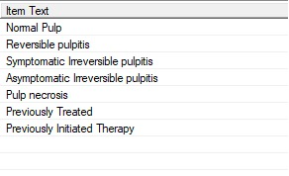
Diagnosis and Treatment

Slide 17
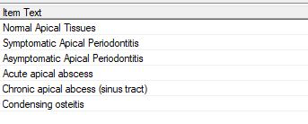
Diagnosis and Treatment

Slide 18
Requirements for Endo Consult
Diagnosis and Treatment page must be completed and reviewed by ER Faculty. Establishment of restorability and prognosis determines if an Endo consult will be initiated.
Protocol sequence for Endo consult :
1) Arch Integrity must be present in order for insurance to cover endo treatment.
2) ENPRCT (Post RCT Tx: crown) consent must be discussed and signed by the patient.
3) Endo referral is reviewed with an approval swipe by Endo faculty to determine whether the case is appropriate for DDS/IDS or Resident.

Slide 19
Informed Consent Post-RCT
ENPRCT – Post Root Canal Necessary Treatment
Attachments/Consents

Slide 20
Endo Referral Form
Used to determine the complexity of an endo case by endo faculty.
If a case is to be referred to a Resident by Endo Faculty:
Indicate a resident case in Axium, email Zandro and Erica Rincon an email with the referral. Include pt’s name, chart #, tooth requiring treatment and endo faculty who approved the referral.
Inform the pt that the Endo department will contact them. Wait times can vary from a few weeks to a few months depending on the demand. See ENPRCT (informed consent)
For acute cases, pts need to be placed on the emergent list.

Slide 21
Emergency Quick List Codes
List of commonly used codes in Emergency clinic
Descriptions for each code
Narratives for each code

Slide 22
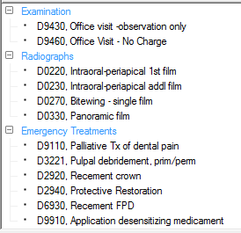
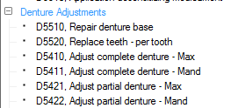
Emergency quick list
Main Clinic

Slide 23
Treatment Plan
Diagnosis
Search For diagnosis
1st
Add Treatment Plan
Ellipsis for Diagnosis
2nd
Full List Tab
Criteria = Tooth Pain
Final
Pain Altered Sensation
Click Plus next to pain

Slide 24
Treatment Plan
Procedure
Search for procedure
1st
Add Procedure
Ellipsis for Procedure
2nd
Quick List Tab
Emergency
Final
Select Procedure(s)
Notes:
Fastest way to obtain ER codes: Quick list> Emergency

Slide 25
Treatment Plan!
CODE any XRAYS TAKEN (PA, BITEWING, PANO, CONE BEAM)
After you present the tx options to the pt, based on your diagnosis, CODE the final tx procedure.
FACULTY REVIEWS ACCURACY OF TREATMENT PLAN AND CODES. APPROVAL SWIPE IS GIVEN. PATIENT SIGNS TX PLAN.
PATIENT IS TAKEN TO THE CASHIER FOR PAYMENT
IF THE INSURANCE COVERAGE IS DENTICAL, P* MUST CLEAR VIA YOUR PCC
TREATMENT CAN BEGIN ONCE PAYMENT HAS BEEN MADE OR P* CLEARS

Slide 26
D9430 Visit for Observation
Examination with diagnosis
Observation only
May include prescribing, reappointing and referral to Oral Surgery
Requires documentation

Slide 27
D9110 Palliative (Emergency) treatment of dental pain
Considered a “Hands On” visit
Minor procedure performed to alleviate acute symptoms of pain/discomfort
Generally means to ease symptoms without curing the underlying problem- NOT DEFINITIVE
Temporary filling, perio related, smoothing sharp tooth
Requires documentation

Slide 28
D9460 No Charge Office Visit
Very few of these in emergency clinic
Active Patients of Record assigned to student
Most common
Temporaries (recement & remake)
Tooth in progress
Denture adjustment- (denture usually less than 1 year)

Slide 29
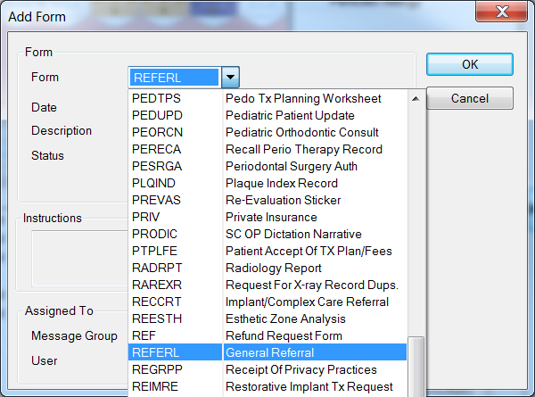
OS Referral

Slide 30
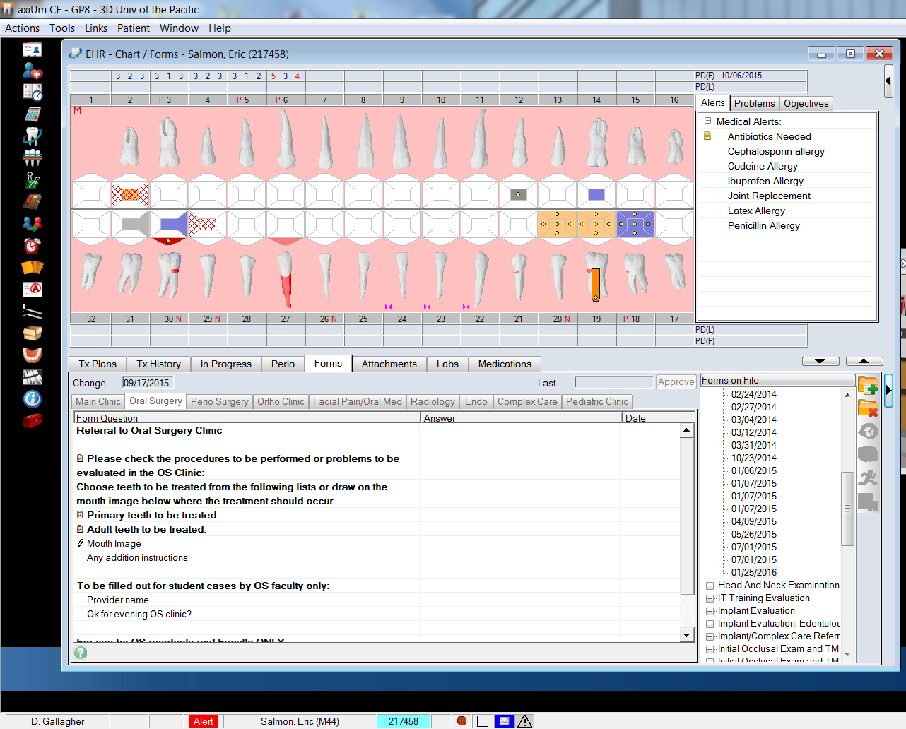
OS Referral

Slide 31
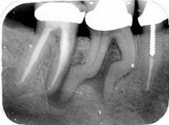
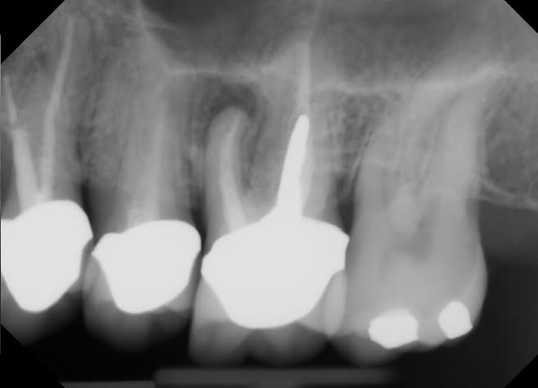
Radiographs Reminder
D0220- First Periapical
D0230-Additional Periapical
D0270-Bitewing,single
D0330 – Panoramic- Remember patient will need to sign treatment plan to get this taken.
Notes:
release for xrays form must be signed at the ER front desk. Xrays are sent by the Emergency Coordinator (Liz) only. Students should not email xrays due to HIPAA concerns.

Slide 32
Documentation
Patient’s Chief Complaint
Diagnosis with correct tooth number or area
Treatment performed. Indicate this visit is Emergency tx only for tooth #_____. List ER faculty and Endo faculty.
D9110 document patient must seek definite treatment

Slide 33
SOAP Note Format Listed under Misc: ER template
S = Subjective
CC: Chief Complaint: What does the pt tell you?
0 = Objective
What you see or measure: Objective/Special Tests
Radiographs, Endo, Perio findings
A= Assessment
What you conclude: What is your diagnosis?
P = Plan or Procedure
What is the treatment plan for the pt today?
DWP : RBA

Slide 34
QUESTIONS?

